Slide 1
http://www.vidyanidhi.com/
ketkiacharya.net@gmail.com
Ketki Acharya
From: SM VITA ATC of CDAC
9769201036
Ketkiacharya.net@gmail.com

Slide 2
Assembly

Slide 3
What is Assembly
Assembly is set of code.
An Assembly can be EXE(console application) or DLL(class library without Main)
There are three type of Assembly
Private Assembly
Shared Assembly
Satellite Assembly

Slide 4
Assembly
An assembly is composed of four sections.
The first is the assembly manifest. The manifest contains information about the assembly, itself. This data includes such things as the name of the assembly, its version number, type mapping information, and cultural settings.
The second section is type metadata, which is information about the data types used by the program. Among other benefits, type metadata aids in cross-language interoperability.
The third part of an assembly is the program code, which is stored in Microsoft Intermediate Language (MSIL) format.
The fourth constituent of an assembly is the resources used by the program.
Fortunately, when using C#, assemblies are produced automatically, with little or no extra effort on your part. The reason for this is that the exe file created when you compile a C# program is actually an assembly that contains your program’s executable code as well as other types of information.
Thus, when you compile a C# program, an assembly is automatically produced.

Slide 5
Manifest Name of Assembly Version info Culture info
Type Metadata (information about data type used in code)
MSIL
Resources like ( images, other dependent file)

Slide 6
Private Assembly
When you create a class library and use it in your application it will create a local copy .
Ie. per project it will have local copy.
In future if you modify this class library then you have to add reference to each project again.

Slide 7
Shared Assembly
It allow you to put your Assembly in GAC-global Assembly cache
All project can use the reference of that Assembly. Ie. no local copy get created
It helps developer to manage versioning

Slide 8
Satellite Assembly
A satellite assembly is a .NET Framework assembly containing resources specific to a given language. Using satellite assemblies, you can place resources for different languages in different assemblies, and the correct assembly is loaded into memory only if the user selects to view the application in that language.
In general, assemblies should contain culture-neutral resources. If you want to localize your assembly (for example use different strings for different locales) you should use satellite assemblies.

Slide 9
How to create class libraray
step 1
start visual studio
select c# on left
select Class Library on right
Write code
save and compile
step 2
start visual studio
select c# on left
select Console Application
in solution explorer right click on references -
add references and select your dll file from bin folder which you created in step 1
compile and run
This way we are creating private Assembly

Slide 10
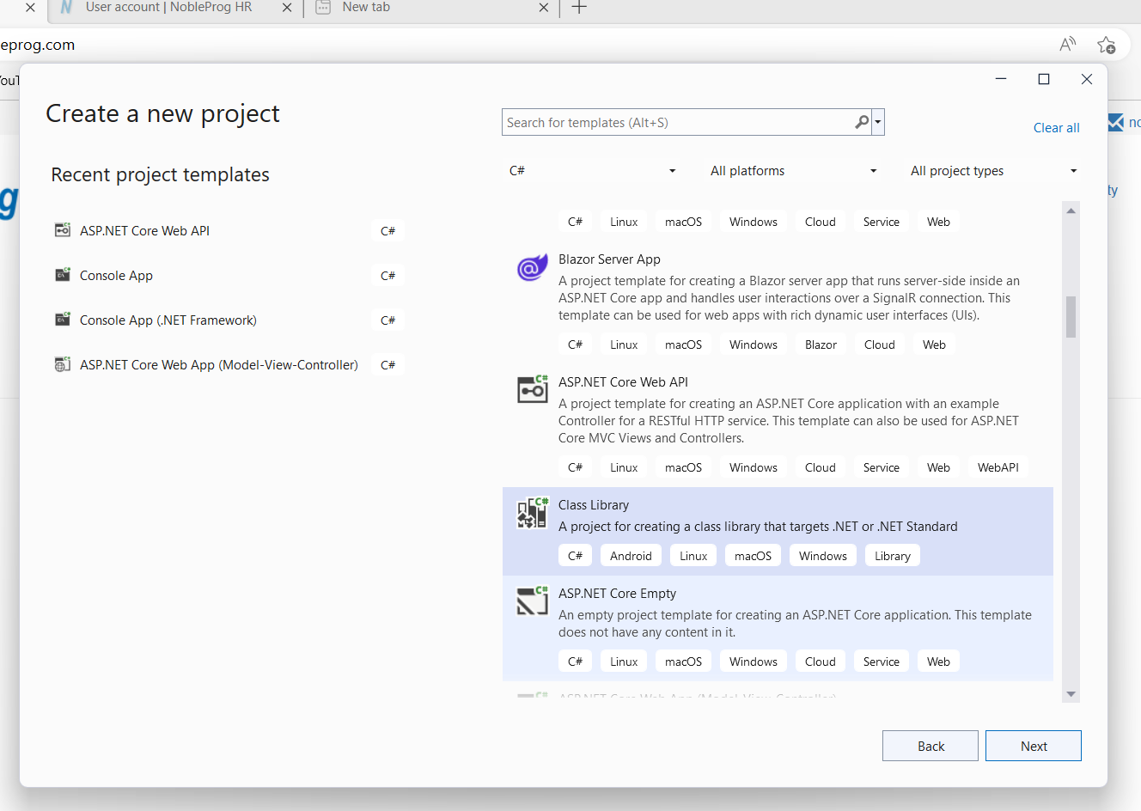

Slide 11
Code for class Library
using System;
namespace meth_lib
{
public class Mathclass
{
public int add(int x, int y)
{
return x + y;
}
}
}
Observe no Main method
Your class must have public access modifier otherwise you can not access it in other project
Observe Method has public access modifier only public method can be available in other project
When you compile this file you will get DLL file

Slide 12
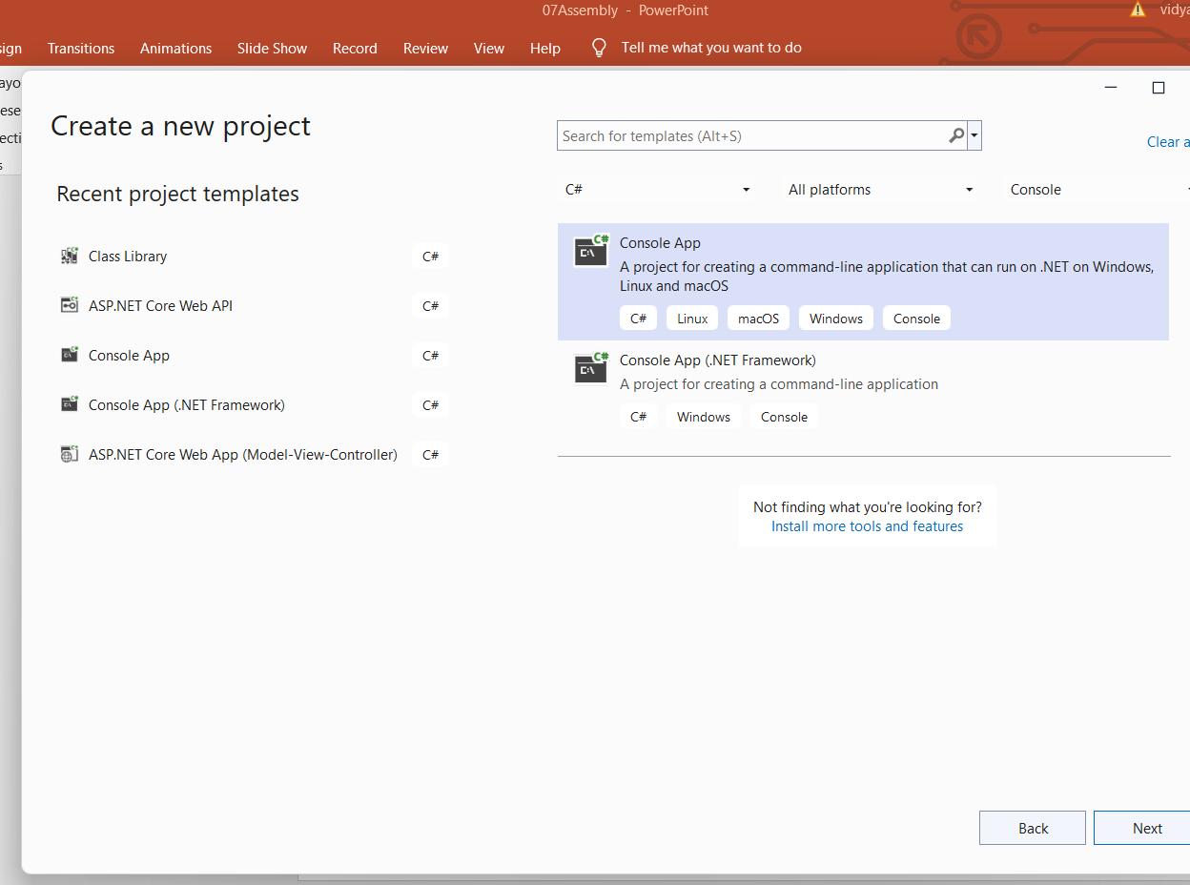

Slide 13
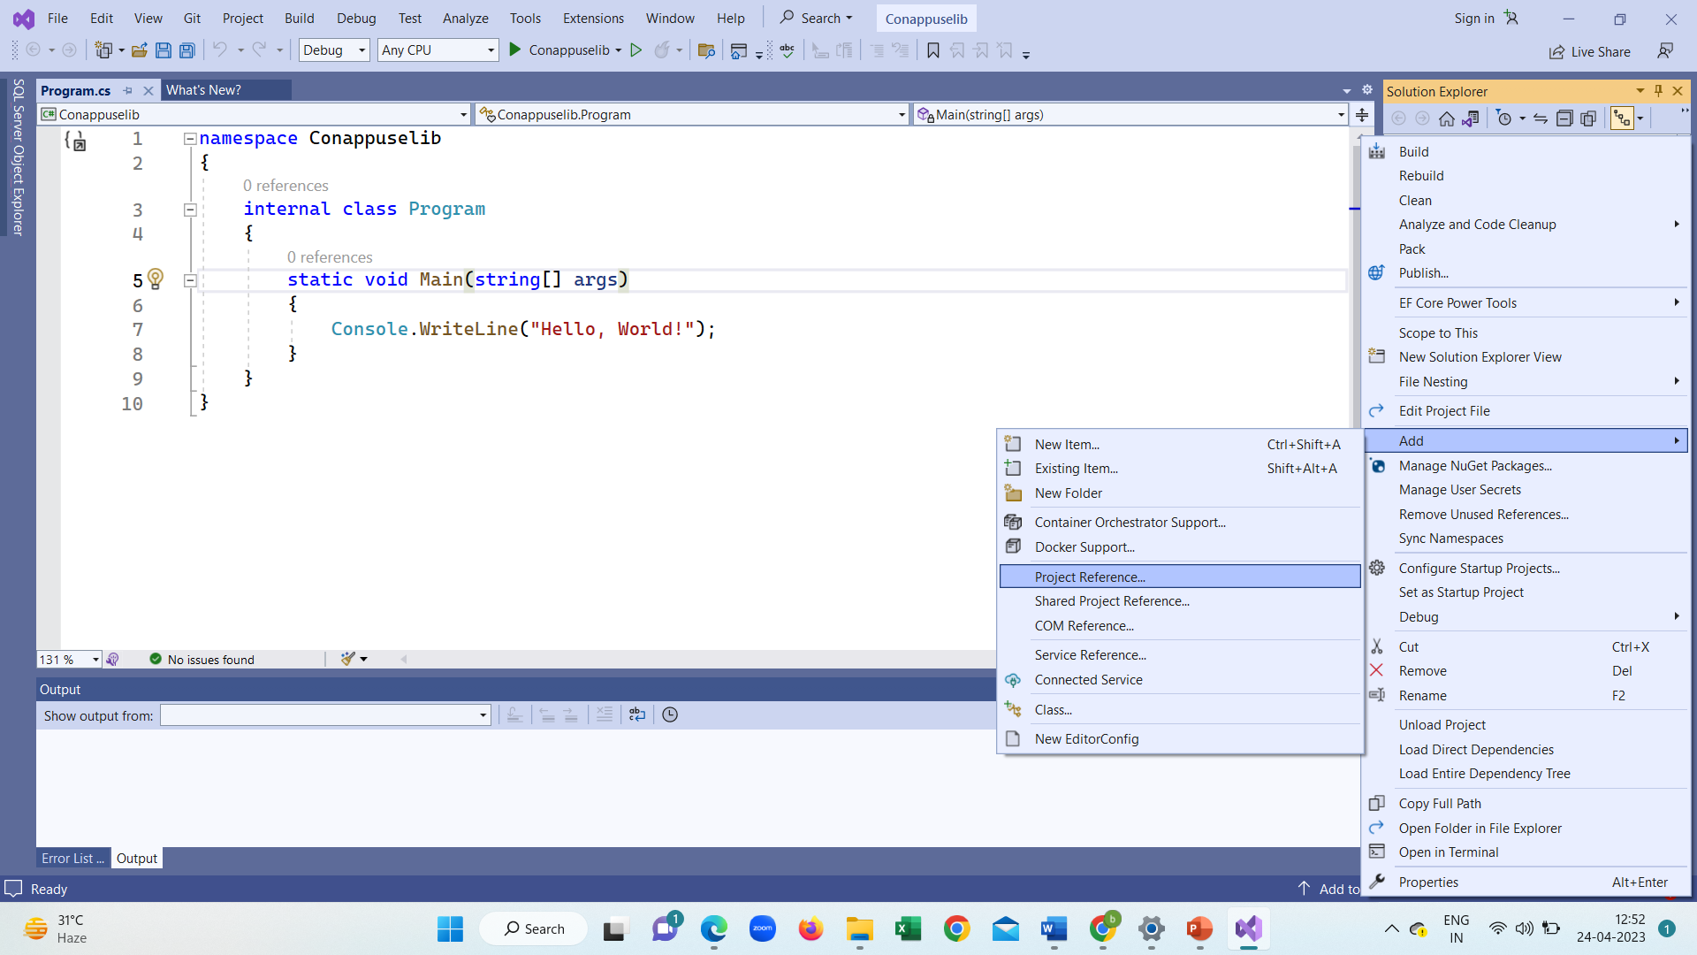

Slide 14
Add reference of dll in console
using System;
using meth_lib;// namespace of classlibrary
namespace useassembly
{
class Program
{
static void Main(string[] args)
{
Mathclass m = new Mathclass();
int r= m.add(5, 4);
Console.WriteLine(r);
Console.ReadLine();
}
}
}
Observe we have to add namespace
using meth_lib
If you do not want to write using
could have written
meth_lib.Mathclass m= meth_lib.Mathclass ();
But in this you have to use name space every time. Using statement become more convenient

Slide 15
How to create shared Assebly
Create class libraray
Signe the Assembly
Add it in GAC

Slide 16
How to signe Assembly
right click on project in solution explorer
click on signing
type name (eg. mysnk) it can be any name
Save
//following staps not required in .NET Core
go to assembly file
and add
[assembly :AssemblyKeyFile("mysnk.snk")]

Slide 17
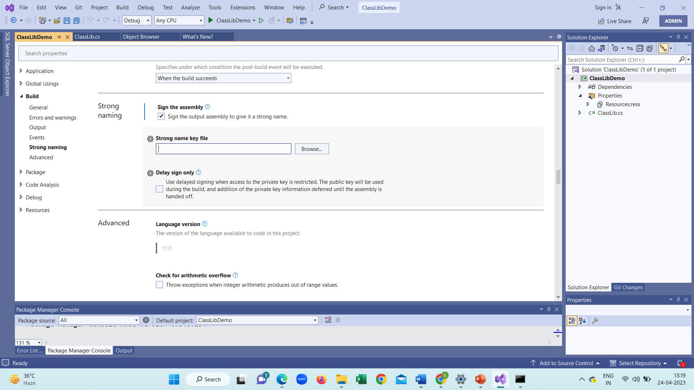
How to sign ➔ go to command prompt➔ type following line where mykey is file name
sn -k mykey.snk
Open following screen and browse mysnk file and build
Go to location of dll file and add it to gac➔gacutil –i classlib.dll

Slide 18
How to add in GAC
start
program
Visual studio 2019
Visual studio tool
right click on cmd run as------------------ administrator------
and type
on path of dll file gacutil -i lib. dll
D:\practice_dotnet\callib\callib\bin\Debug\ gacutil -i lib. dll
add reference to your project from the following path C:\Windows\Microsoft.NET\assembly\GAC_MSIL\ClassLibrary1

Slide 19
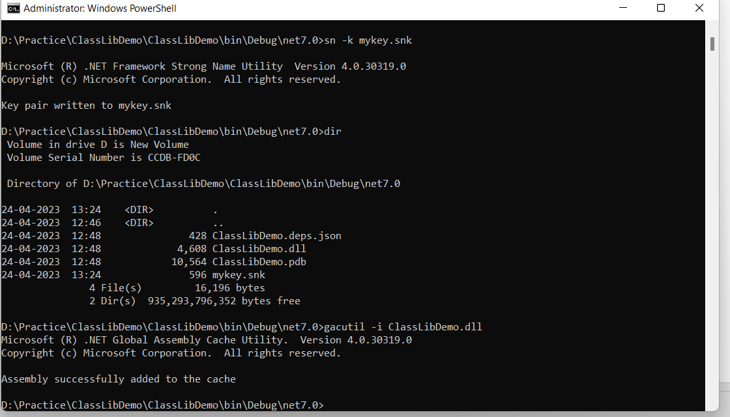

Slide 20
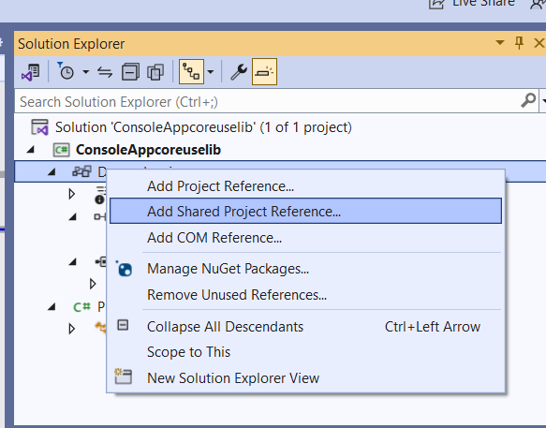
How to Add reference

Slide 21
Q1 create a class library having public method which will return square of a number use this dll file in your console application.(private Assembly)
Q2. put your class libraray in GAC and use it in console application(Shared Assembly)
C:\Windows\Microsoft.NET\assembly\GAC_MSIL\ClassLibrarycore\v4.0_1.0.0.0__a4807bbf84f09258
Microsoft.VisualStudio.Shell.11.0.dll

Slide 22
DLL Hell
Shared ABC. DLL///overwrite
New Game A
Game A

Slide 23
Versioning
Shared ABC. DLL
Shared ABC. DLL
New Game A
Game A

Slide 24
Create class Library in VSCode
Create a solution
Start by creating a blank solution to put the class library project in. A solution serves as a container for one or more projects. You'll add additional, related projects to the same solution.
Start Visual Studio Code.
Select File > Open Folder (Open... on macOS) from the main menu
In the Open Folder dialog, create a ClassLibraryProjects folder and click Select Folder (Open on macOS).
Open the Terminal in Visual Studio Code by selecting View > Terminal from the main menu.
The Terminal opens with the command prompt in the ClassLibraryProjects folder.
In the Terminal, enter the following command:
.NET CLI
dotnet new sln
The terminal output looks like the following example:
Output The template "Solution File" was created successfully.

Slide 25
Create a class library project
Add a new .NET class library project named "StringLibrary" to the solution.
In the terminal, run the following command to create the library project:
.NET CLI
dotnet new classlib -o StringLibrary
The -o or --output command specifies the location to place the generated output.
The terminal output looks like the following example:
Output
The template "Class library" was created successfully.
Processing post-creation actions...
Running 'dotnet restore' on StringLibrary\StringLibrary.csproj...
Determining projects to restore...
Restored C:\Projects\ClassLibraryProjects\StringLibrary\StringLibrary.csproj (in 328 ms).
Restore succeeded.

Slide 26
Run the following command to add the library project to the solution:
.NET CLI
dotnet sln add StringLibrary/StringLibrary.csproj
The terminal output looks like the following example:
Output
Project `StringLibrary\StringLibrary.csproj` added to the solution.

Slide 27
Check to make sure that the library targets .NET 5.
In Explorer, open StringLibrary/StringLibrary.csproj.
The TargetFramework element shows that the project targets .NET 5.0.
<Project Sdk="Microsoft.NET.Sdk">
<PropertyGroup>
<TargetFramework>net5.0</TargetFramework>
</PropertyGroup>
</Project>

Slide 28
Open Class1.cs and replace the code with the following code.
using System;
namespace UtilityLibraries
{
public static class StringLibrary
{
public static bool StartsWithUpper(this string str)
{
if (string.IsNullOrWhiteSpace(str))
return false;
char ch = str[0];
return char.IsUpper(ch);
}
}
}
The class library, UtilityLibraries.StringLibrary, contains a method named StartsWithUpper. This method returns a Boolean value that indicates whether the current string instance begins with an uppercase character. The Unicode standard distinguishes uppercase characters from lowercase characters. The Char.IsUpper(Char) method returns true if a character is uppercase.
StartsWithUpper is implemented as an extension method so that you can call it as if it were a member of the String class.
Save the file.
Run the following command to build the solution and verify that the project compiles without error. .NET CLI dotnet build

Slide 29
The terminal output looks like the following example:
Output
Microsoft (R) Build Engine version 16.7.0+b89cb5fde for .NET
Copyright (C) Microsoft Corporation. All rights reserved.
Determining projects to restore...
All projects are up-to-date for restore.
StringLibrary -> C:\Projects\ClassLibraryProjects\StringLibrary\bin\Debug\net5.0\StringLibrary.dll
Build succeeded.
0 Warning(s)
0 Error(s)
Time Elapsed 00:00:02.78

Slide 30
Add a console app to the solution
Add a console application that uses the class library. The app will prompt the user to enter a string and report whether the string begins with an uppercase character.
In the terminal, run the following command to create the console app project:
.NET CLI
dotnet new console -o ShowCase
The terminal output looks like the following example:
Output
The template "Console Application" was created successfully. Processing post-creation actions... Running 'dotnet restore' on ShowCase\ShowCase.csproj... Determining projects to restore... Restored C:\Projects\ClassLibraryProjects\ShowCase\ShowCase.csproj (in 210 ms). Restore succeeded.
Run the following command to add the console app project to the solution:
.NET CLI
dotnet sln add ShowCase/ShowCase.csproj
The terminal output looks like the following example:
Output
Project `ShowCase\ShowCase.csproj` added to the solution.

Slide 31
Open ShowCase/Program.cs and replace all of the code with the following code. C#Copy
using System;
using UtilityLibraries;
class Program
{
static void Main(string[] args)
{
int row = 0;
do
{
if (row == 0 || row >= 25)
ResetConsole();
string input = Console.ReadLine();
if (string.IsNullOrEmpty(input)) break;
Console.WriteLine($"Input: {input} {"Begins with uppercase? ",30}: " + $"{(input.StartsWithUpper() ? "Yes" :: "No") } {Environment.NewLine}");
row += 3;
} while (true);
return;
// Declare a ResetConsole local method
void ResetConsole()
{
if (row > 0)
{ Console.WriteLine("Press any key to continue...");
Console.ReadKey();
}
Console.Clear();
Console.WriteLine($"{Environment.NewLine}Press <Enter> only to exit; otherwise, enter a string and press <Enter>:{Environment.NewLine}");
row = 3;
}
}
}

Slide 32
The code uses the row variable to maintain a count of the number of rows of data written to the console window. Whenever it's greater than or equal to 25, the code clears the console window and displays a message to the user.
The program prompts the user to enter a string. It indicates whether the string starts with an uppercase character. If the user presses the Enter key without entering a string, the application ends, and the console window closes.
Save your changes.

Slide 33
Add a project reference
Initially, the new console app project doesn't have access to the class library. To allow it to call methods in the class library, create a project reference to the class library project.
Run the following command:
.NET CLI
dotnet add ShowCase/ShowCase.csproj reference StringLibrary/StringLibrary.csproj
The terminal output looks like the following example:
Output
Reference `..\StringLibrary\StringLibrary.csproj` added to the project

Slide 34
Run the app
Run the following command in the terminal:
.NET CLI
dotnet run --project ShowCase/ShowCase.csproj
Try out the program by entering strings and pressing Enter, then press Enter to exit.
The terminal output looks like the following example:
Output
Press <Enter> only to exit; otherwise, enter a string and press <Enter>: A string that starts with an uppercase letter Input: A string that starts with an uppercase letter Begins with uppercase? : Yes a string that starts with a lowercase letter Input: a string that starts with a lowercase letter Begins with uppercase? : No

